Slide 1
Assembly Coordinate System

Slide 2
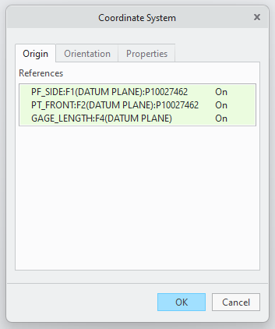
Editing Coordinate System
Select Coordinate System in "Model Tree" Dialog Box (Boxed in red)
Model Tab > Datum Ribbon > Coordinate System
Name > DYNAMIC_CSYS

Slide 3
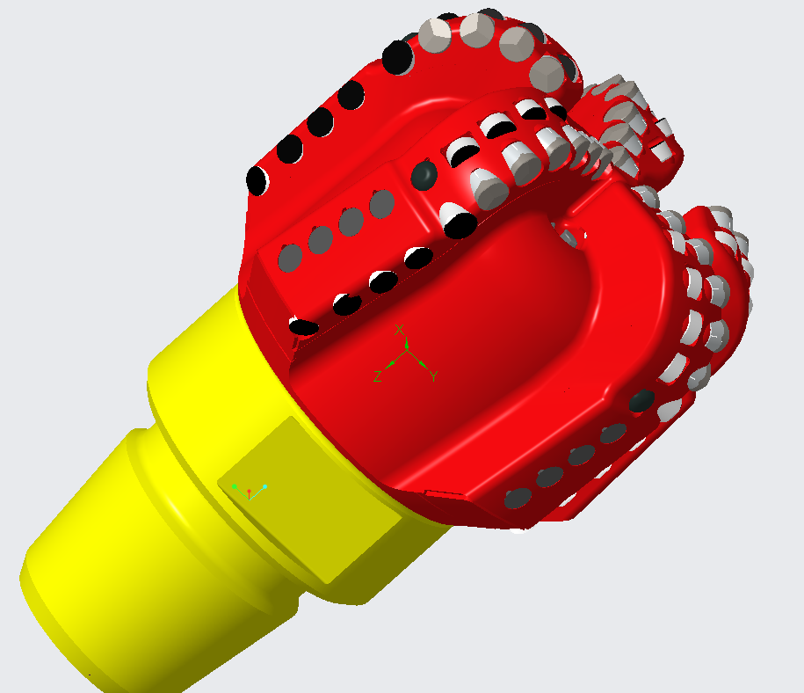
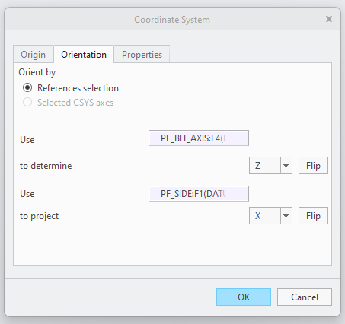
Orienting Coordinate System
Set Orientation Objects
Match Axis Orientation as shown (Use Flip)
X axis oriented parallel to blade 1 face
Y axis oriented down when X axis due right
Z axis oriented to drillstring

Slide 4
Part Coordinate System

Slide 5
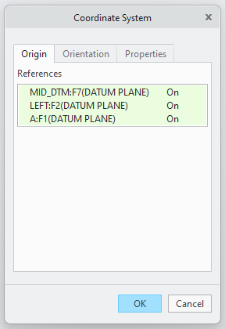
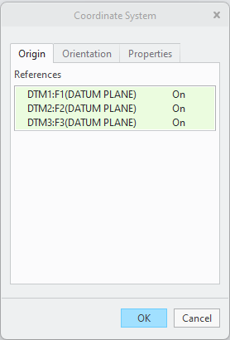
Creating Coordinate System / Setting Origin
Select Parts (Boxed in red depending on "Body 1" elements)
Model Tab > Datum Ribbon > Coordinate System
Name > DYNAMIC_CSYS

Slide 6
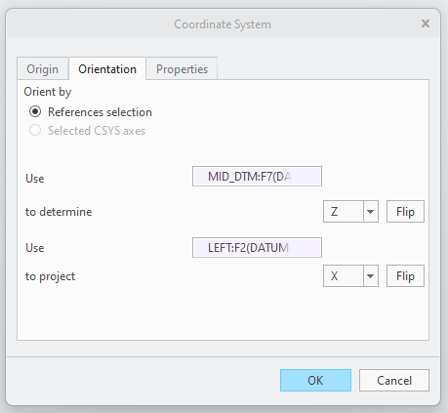
Orienting Coordinate System
Set Orientation Objects
Match Axis Orientation as shown on next slides (Use Flip)
X axis set normal to cutter face
Y axis pointing to right when looking into X axis with Z axis pointing up
Z axis set normal to cutting contact point

Slide 7
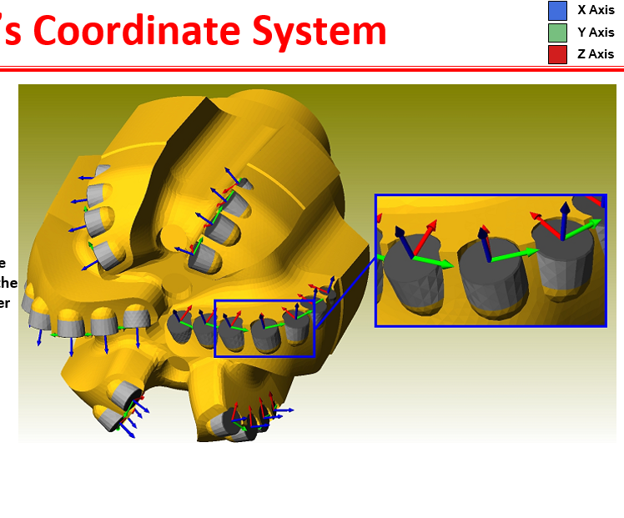

Slide 8
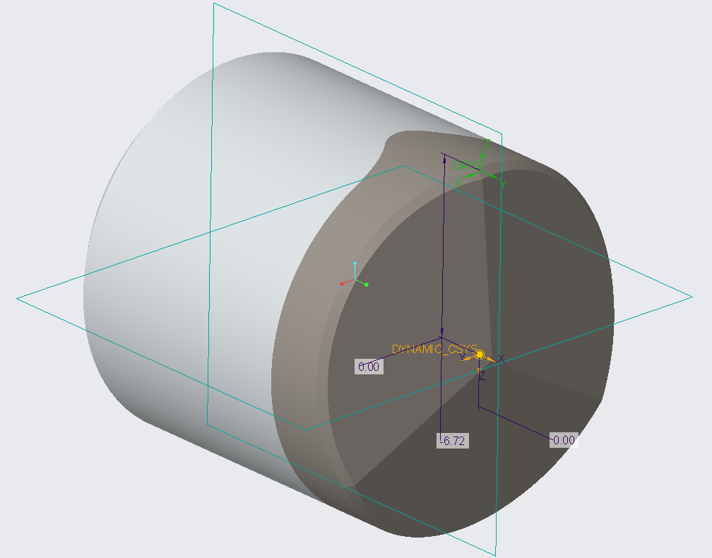
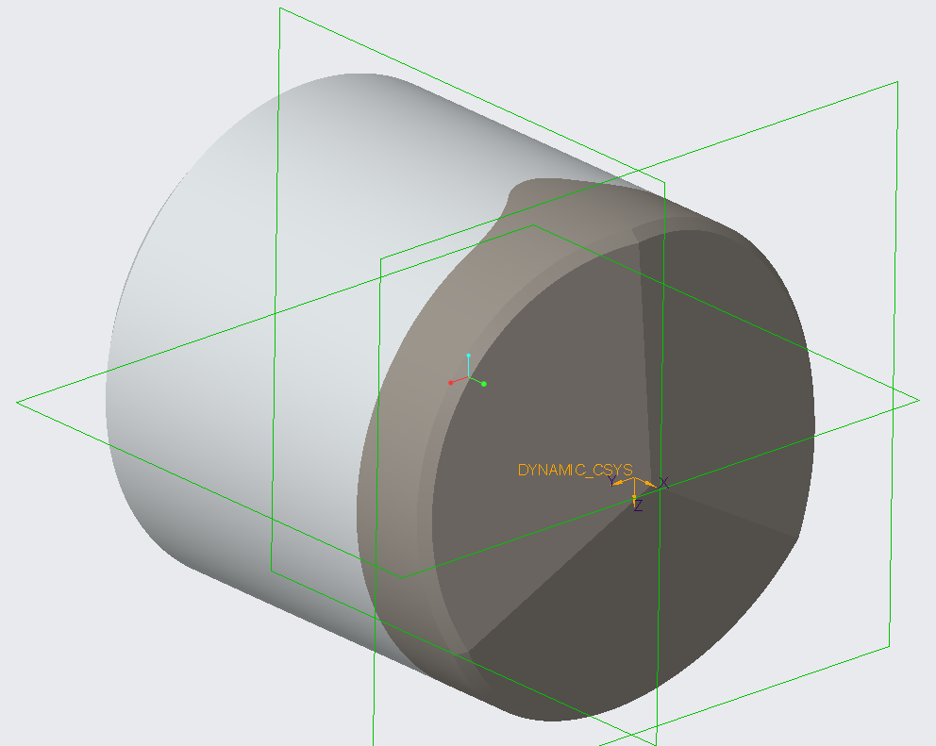

Slide 9
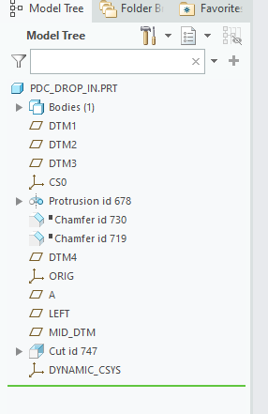
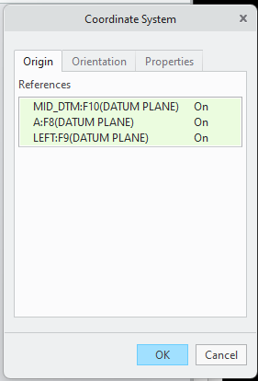
Orienting Coordinate System
Set Orientation Objects
Match Axis Orientation as shown on next slides (Use Flip)
X axis set normal to cutter face
Y axis pointing to right when looking into X axis with Z axis pointing up
Z axis set normal to cutting contact point

Slide 10
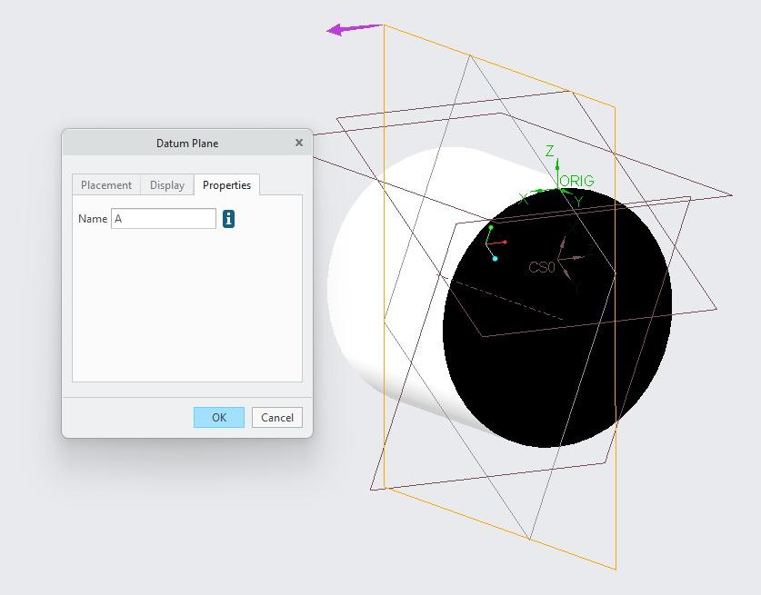
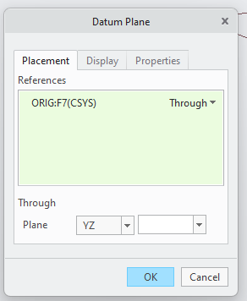

Slide 11
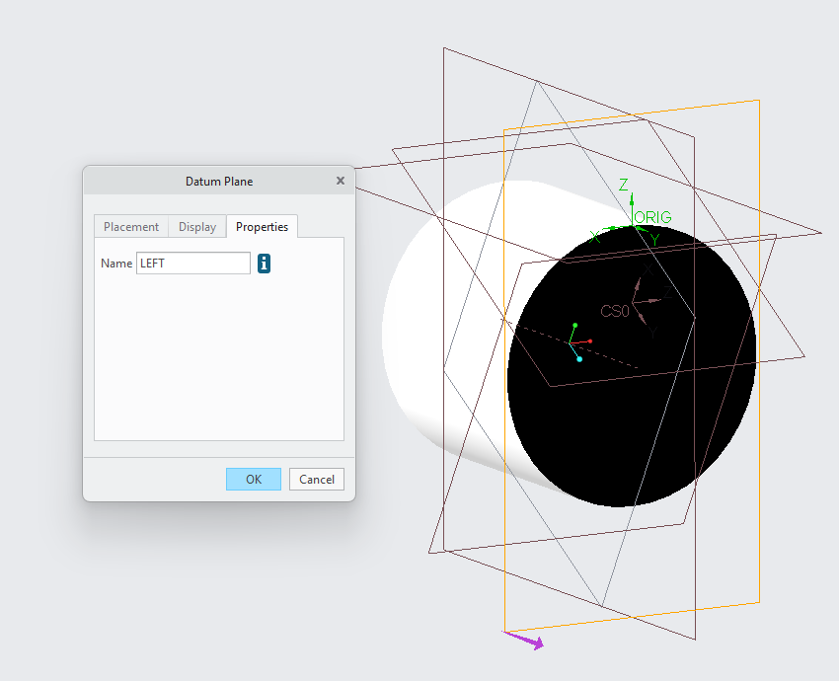
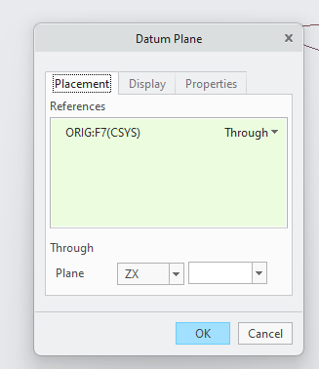

Slide 12
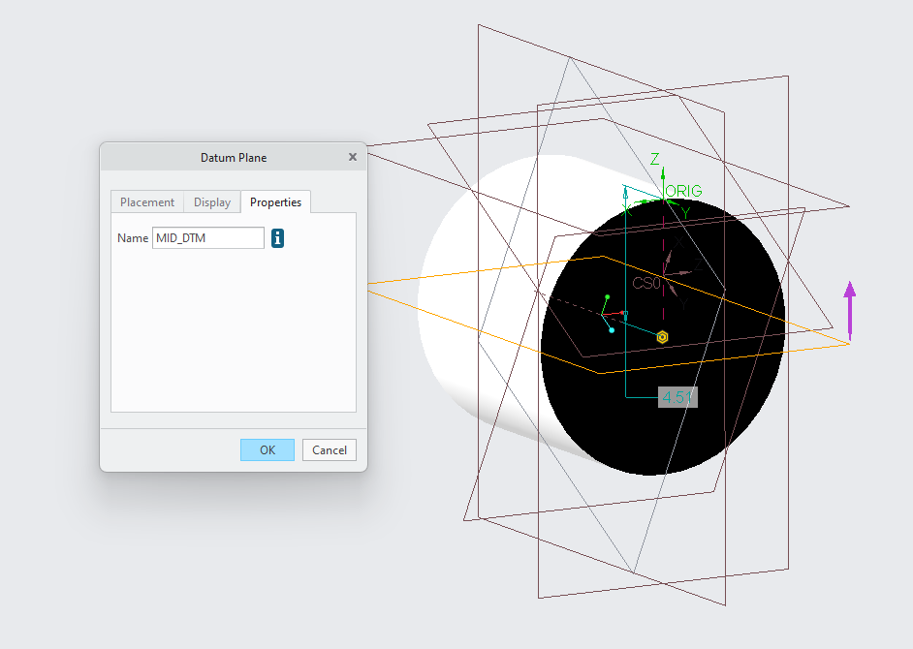
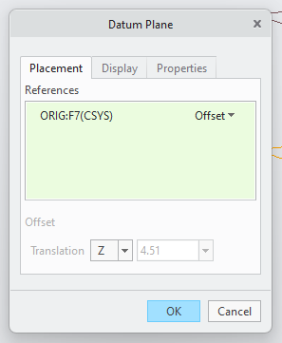

Slide 13
Last Slide

